Slide 1
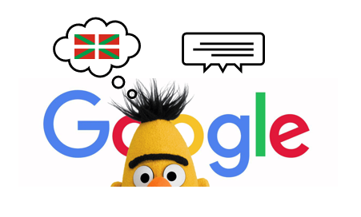
Question Answering Using Large-language Models On A Minority Language (BASQUE)
Aimar Silvan, BME I9400 – Special Topics in Machine Learning Fall 2024, The City College of New York

Slide 2
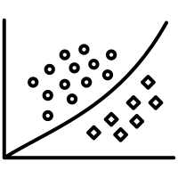
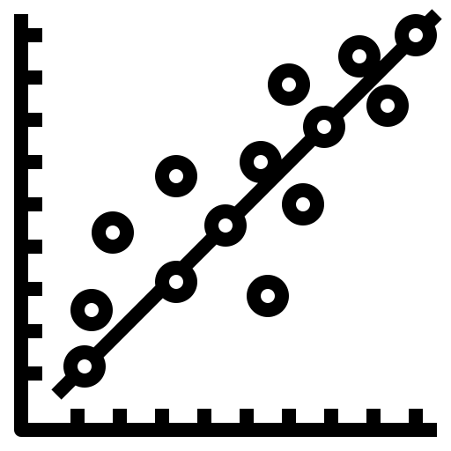

Why This Project?
We are all familiar with common applications of Deep Learning….
Classification
Regression
Natural Language Processing (NLP)

Slide 3
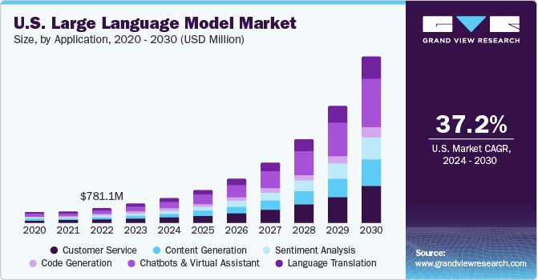
Why This Project?
LLMs usage is only going to grow from now
Natural Language Processing (NLP)

Slide 4

A short introduction to LLMs
Predicting the next work from past inputs: It’s all math (probabilities)!
Source: 3Blue1Brown, YouTube

Slide 5
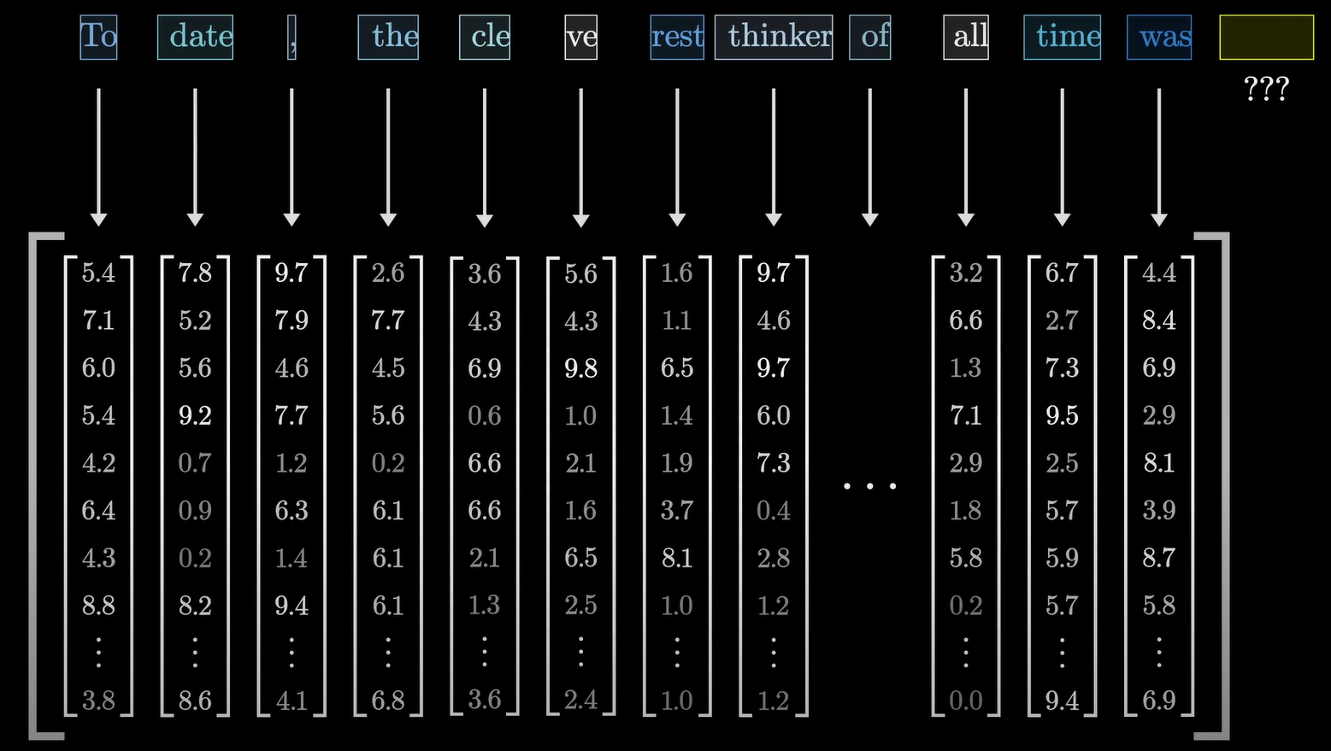
A short introduction to LLMs
Predicting the next work from past inputs: It’s all math (probabilities)!
But computers can’t understand words -> So we embed words using tokens
This looks an awful lot like regression, but…
Language is very complex, we need to understand semantic context, and so do computers
Source: 3Blue1Brown, YouTube

Slide 6
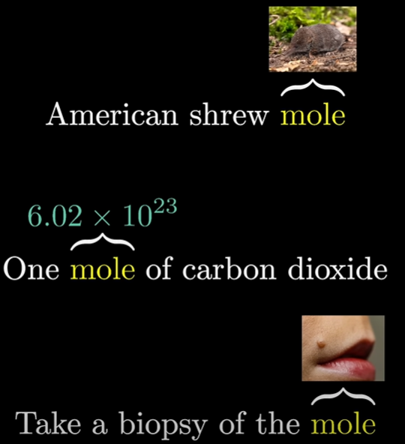
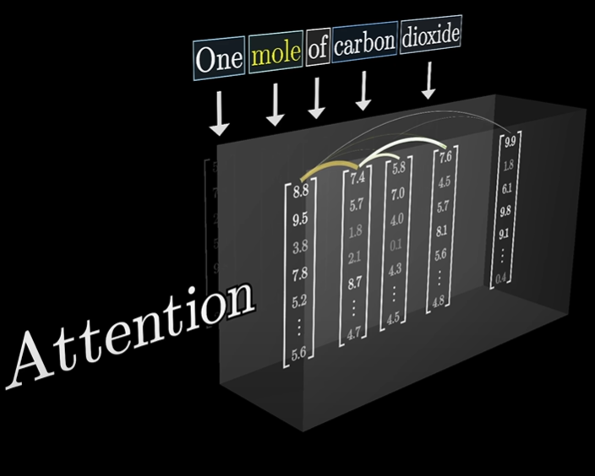
A short introduction to LLMs
TRANSFORMERS, or how to focus on what matters (attention)
A “magic” block:
They focus on all words at the same time
They know which words are most important, i.e., and adjective might serve to identify what a noun means
Source: 3Blue1Brown, YouTube

Slide 7
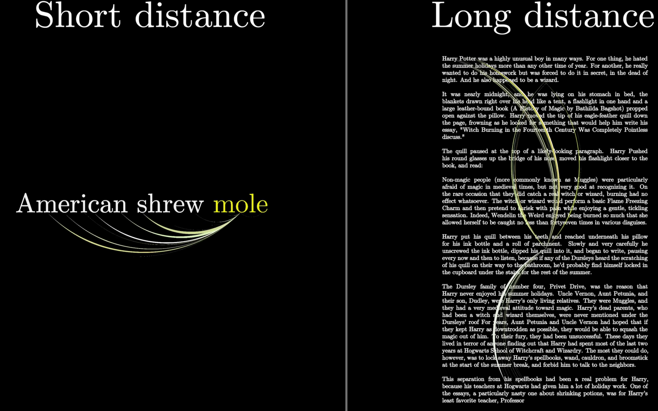
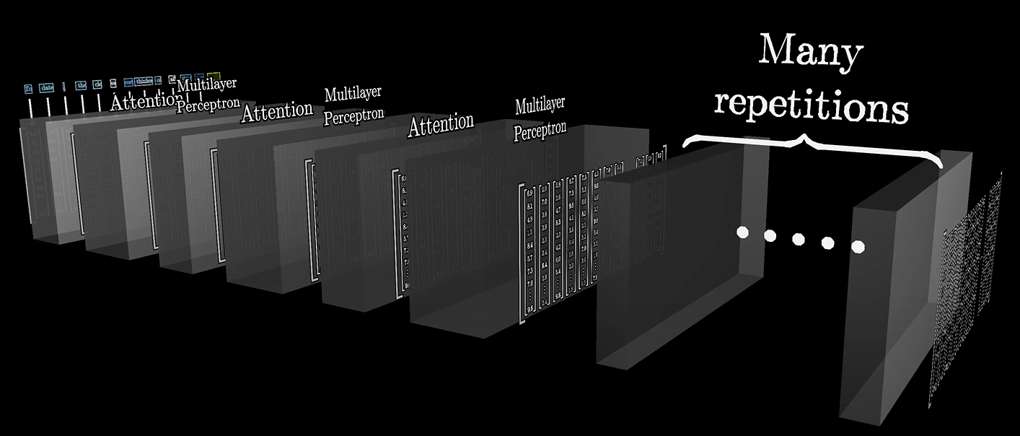
A short introduction to LLMs
TRANSFORMERS, or how to focus on what matters (attention)
If we need larger context spans, we need more parameters
Training these models is VERY expensive, and they need a TON of data
(thus the Large in Large-Language Models)
Source: 3Blue1Brown, YouTube

Slide 8
An achievable objective
Training these models is VERY expensive, and they need a TON of data
Current SOTA models are trained on the ENTIRETY of the internet (think ChatGPT, Llama, Gemini…)
I can use a pretrained model
(so it already knows about language) and I can fine tune it for a given task
So if I want to do something similar on my computer I obviously need to scale down
Question Answering: A classic task for NLP models, given a text, provide an answer
Context
Question
Answers
Beyoncé Giselle Knowles-Carter (/biːˈjɒnseɪ/ bee-YON-say) (born September 4, 1981) is an American singer, songwriter, record producer and actress. Born and raised in Houston, Texas, she performed in various singing and dancing competitions as a child, and rose to fame in the late 1990s as lead singer of R&B girl-group Destiny's Child. Managed by her father, Mathew Knowles, the group became one of the world's best-selling girl groups of all time. Their hiatus saw the release of Beyoncé's debut album, Dangerously in Love (2003), which established her as a solo artist worldwide, earned five Grammy Awards and featured the Billboard Hot 100 number-one singles "Crazy in Love" and "Baby Boy".
When did Beyonce start becoming popular?
{"text": [ "in the late 1990s" ], "answer_start": [ 269 ] }

Slide 9
Question Answering LLMs: nothing new out there
Two very popular datasets:
Rajpurkar, P., Zhang, J., Lopyrev, K., & Liang, P. (2016). SQuAD: 100,000+ Questions for Machine Comprehension of Text. ArXiv. https://arxiv.org/abs/1606.05250
SQuAD 1.1: contains 100,000+ question-answer pairs on 500+ Wikipedia articles.
Rajpurkar, P., Jia, R., & Liang, P. (2018). Know What You Don't Know: Unanswerable Questions for SQuAD. ArXiv. https://arxiv.org/abs/1806.03822
SQuAD2.0: 100,000 questions in SQuAD1.1 with over 50,000 unanswerable questions handmade to look like answerable ones
Tricking the machine: If you don’t know, you shouldn’t answer

Slide 10
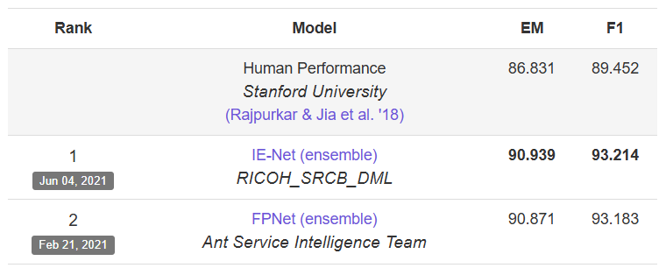
Question Answering LLMs: nothing new out there
Both datasets have been well explored (11,976 citations on GS, as of Nov. 2024)
Performance Metrics:
F1: harmonic mean of precision and recall *
Precision: number of correct words divided by the number of words in the predicted answer
Recall: number of correct words divided by the number of words in the ground truth answer
Exact Match: binary measure (0 or 1) checking if the model outputs match one of the ground truth answers exactly *
Computers have beaten human performance:
* For negative (empty, inexistent ground truth answer) examples, abstaining receives a score of 1, and any other response gets 0, for both exact match and F1
So how could I make it more interesting?
https://rajpurkar.github.io/SQuAD-explorer/

Slide 11
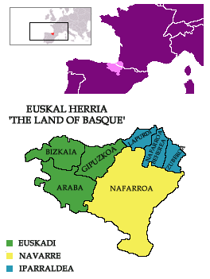

Question Answering NLP: Basque as a minority language
Most LLMs are trained mostly in English or other extensively used languages, which results in big biases towards these majority languages, but who thinks about the other language-speakers?
Some fun facts:
Around 806,000 people speak Basque, but in the Basque Country, only 30.6% of the population over 16 years old speaks Basque
It is unrelated to all known languages
Its origin is older than that of any other language in Europe

Slide 12
Question Answering NLP: Basque as a minority language
Increased efforts towards LLMs on minority languages:
Perez, N., Cuadros, M., & Bengoetxea, J. (2024). EuSQuAD: Automatically Translated and Aligned SQuAD2.0 for Basque. ArXiv. https://arxiv.org/abs/2404.12177
Beyoncé Giselle Knowles-Carter (/biːˈjɒnseɪ/ bee-YON-say) (born September 4, 1981) is an American singer, songwriter, record producer and actress. Born and raised in Houston, Texas, she performed in various singing and dancing competitions as a child, and rose to fame in the late 1990s as lead singer of R&B girl-group Destiny's Child. Managed by her father, Mathew Knowles, the group became one of the world's best-selling girl groups of all time. Their hiatus saw the release of Beyoncé's debut album, Dangerously in Love (2003), which established her as a solo artist worldwide, earned five Grammy Awards and featured the Billboard Hot 100 number-one singles "Crazy in Love" and "Baby Boy".
Beyonce Giselle Knowles-Carter (New York, Ameriketako Estatu Batuak, 1981eko irailaren 4a) estatubatuar abeslari, kantautore, ekoizle eta aktorea da. Houstonen (Texas) jaio eta hazi zen, eta txikitan hainbat kantu eta dantza lehiaketatan aritu zen, eta 1990eko hamarkadaren amaieran Destiny 's Child R & B neska taldeko abeslari nagusi gisa ospea lortu zuen. Bere aitak, Mathew Knowlesek, zuzentzen zuen taldea munduko neska talde salduenetako bat bihurtu zen. Haien hiatoek Beyonceren debut albuma argitaratu zuten, Dangerously in Love (2003), mundu osoan bakarlari gisa ezarri zuena, bost Grammy Sari irabazi zituen eta \"Crazy in Love\" eta \"Baby Boy\" singleak aurkeztu zituen.
When did Beyonce start becoming popular?
Noiz hasi zen Beyonce ezagun egiten?
{"text": [ "in the late 1990s" ],
"answer_start": [ 269 ] }
{"text": ["1990eko hamarkadaren amaieran"],
"answer_start": [253]}}
1:1 translation of the SQuAD2.0 Dataset (including negative answers)

Slide 13

Question Answering NLP: Working my way through the task
My first approach: try to replicate a previous implementation (using SQuAD2.0, and BERT)
The BERT model
Self-supervised pre-training on English corpus:
Masked Language Modelling (try to predict missing word)
Next Sentence Prediction (learn if the next sentence is a continuation of a given sentence)
Has bidirectional understanding of sentences
Inner Representation of Language using 110M parameters
https://huggingface.co/google-bert/bert-base-uncased

Slide 14
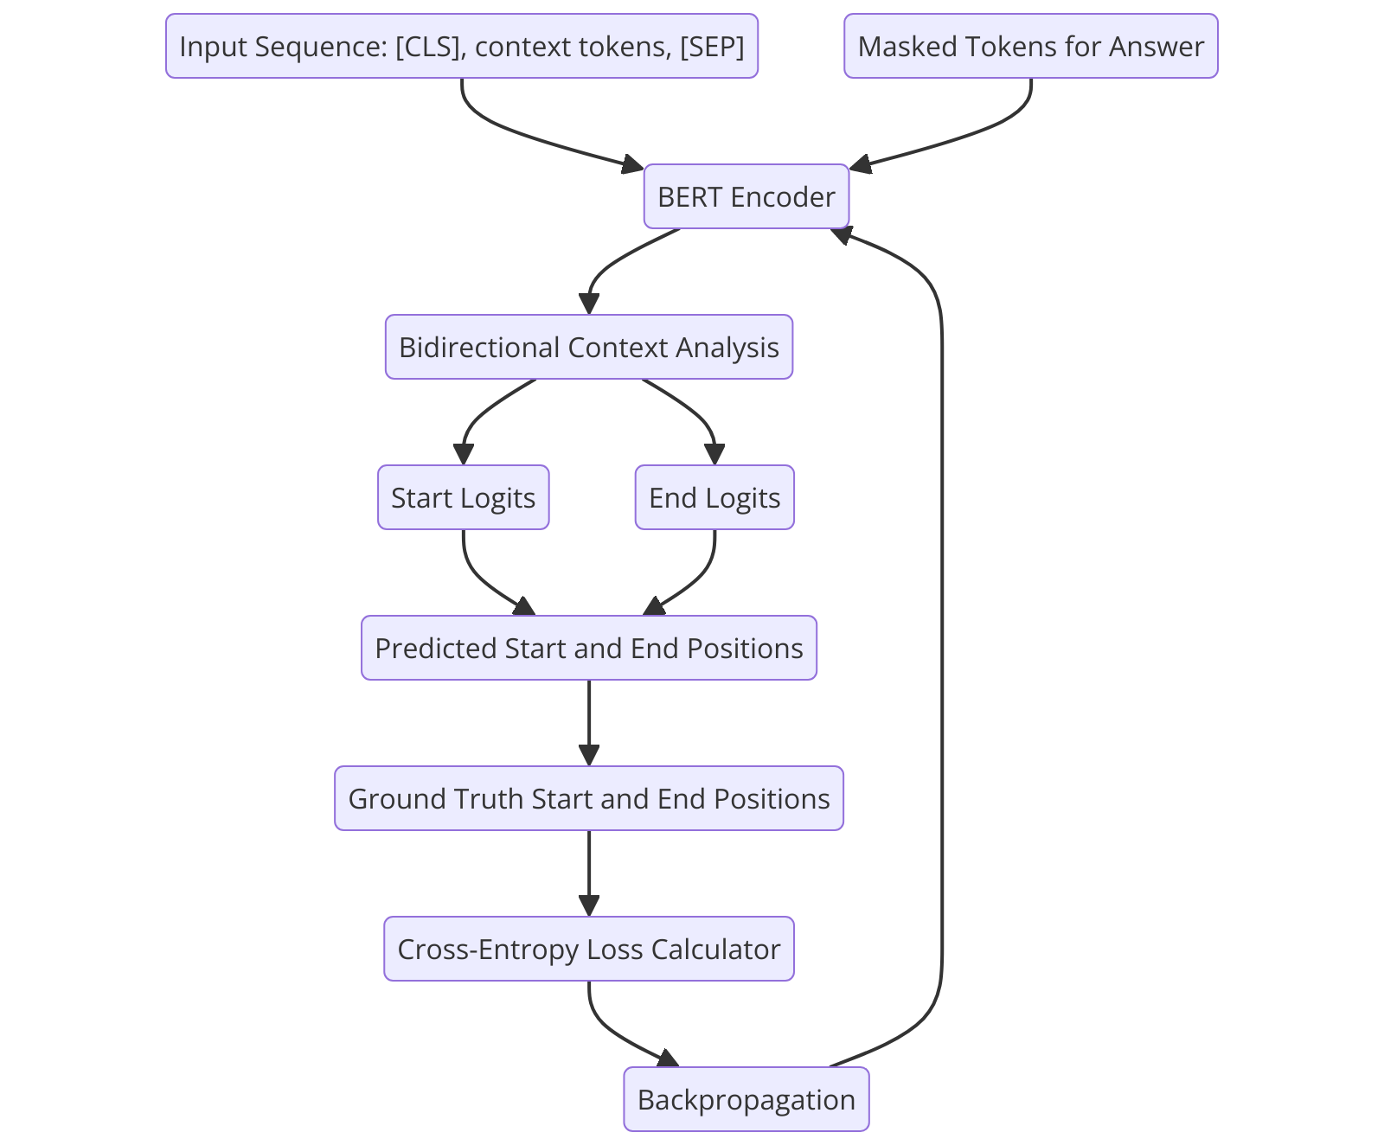
Question Answering NLP: Working my way through the task
The BERT model
How do we train it to predict an answer from a given text?
Very clever solution:
Feed it the tokenized context, question and answer
For each token in the context, predict the probabilities of it being either the start or the end of the answer, this process is called predicting the logits
Compare predicted logits vs. ground truth logits: cross-entropy-loss
Backpropagate
REPEAT
A
LOT
Seriously, a lot
~ 24 hours for each attempt at training

Slide 15

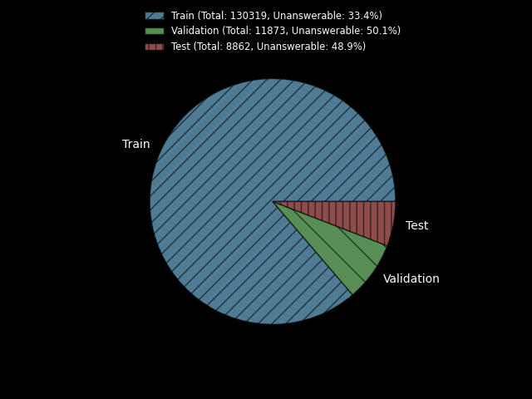
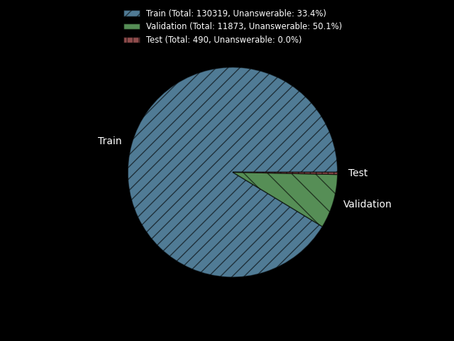
Question Answering NLP: a problem with the datasets
And after struggling with setting up the models and the datasets for training, I started training…
But I made the biggest mistake someone can make in ML:
What about the test set????
Original datasets:
SQuAD2.0 Dataset
EuSQuAD Dataset
Manually crafted
No negative answers
Most importantly, asked the authors to share the test set, and they did not for copyright issues
Private
~2 weeks for evaluation on test set

Slide 16
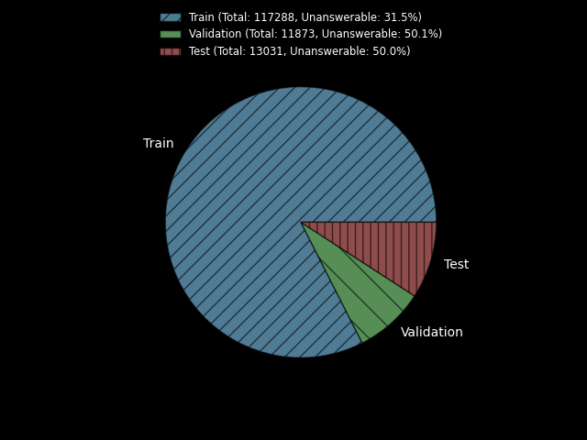

Question Answering NLP: a problem with the datasets
So I had to restart from the beginning…
Leave-out 10% of the training data for testing
Pseudorandom approach:
50/50 answerable/unanswerable questions
“Modified” datasets:
SQuAD2.0 Dataset
EuSQuAD Dataset

Slide 17


Question Answering NLP: different approaches
From more general (and easier), to more specific
Fine tune
The BERT model
SQuAD2.0 Dataset
The mBERT model
Trained on the top 104 languages on Wikipedia, including Basque
Fine tune
EuSQuAD Dataset
Fine tune
The ixamBERT model
Trained on English, Spanish, and Basque
EuSQuAD Dataset
Fine tune
The BERTeus model
Fully trained on Basque
EuSQuAD Dataset

Slide 18
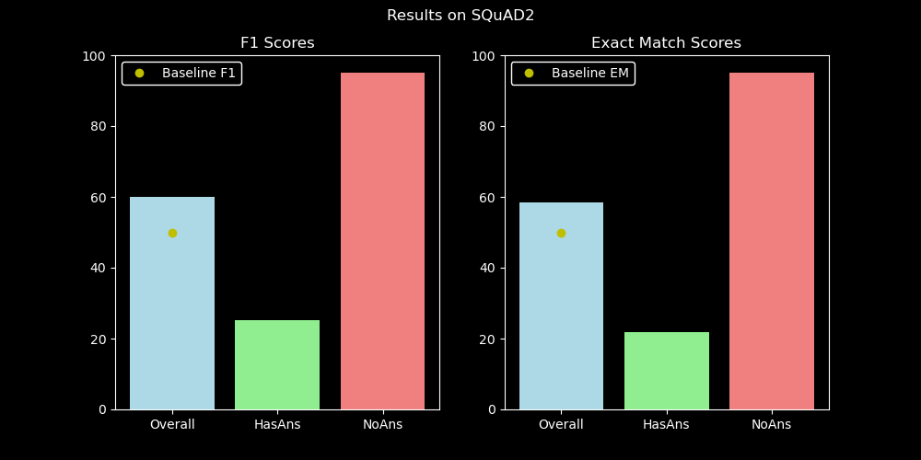
Question Answering NLP: results on the English QA
Keeping it simple: using the same hyperparameters as those in the EuSQuAD paper, can we replicate the results?
hyperparameters = {
'learning_rate': 3e-5,
'num_train_epochs’: 6,
'batch_size’: 8,
'gradient_accumulation_steps': 16,
'weight_decay': 0.02,
'warmup_ratio': 0.2
}
The BERT model
Fine tune
SQuAD2.0 Dataset
Model performance: F1 = 50+, EM = 50+ (better than naive "unanswerable" baseline).
Human performance benchmark: F1 = 89.452, EM = 86.13.
Model catches most non-answerable questions correctly.
Struggles with exact match on answerable questions, often a few words off.
(take into account that our test set is different from the one in this leaderboard, so this is just as an orientation)
* Baseline: performance of a model that always abstains from answering

Slide 19
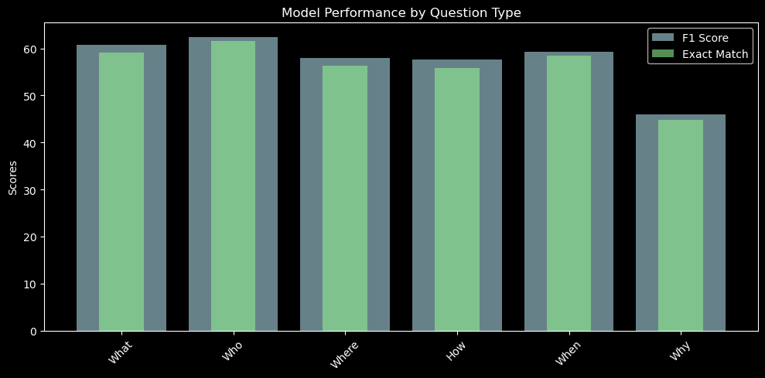
Question Answering NLP: results on the English QA
Keeping it simple: using the same hyperparameters as those in the EuSQuAD paper, can we replicate the results?
The BERT model
Fine tune
SQuAD2.0 Dataset
Model struggles with more abstract questions like “why”, compared to simpler ones like “who”

Slide 20
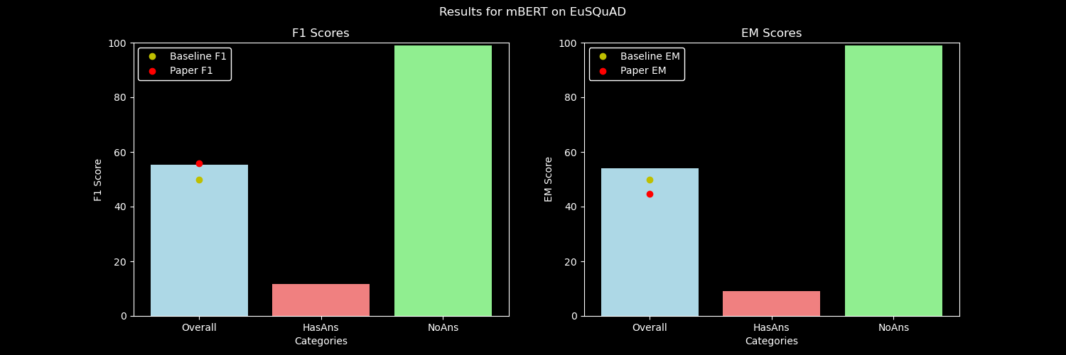
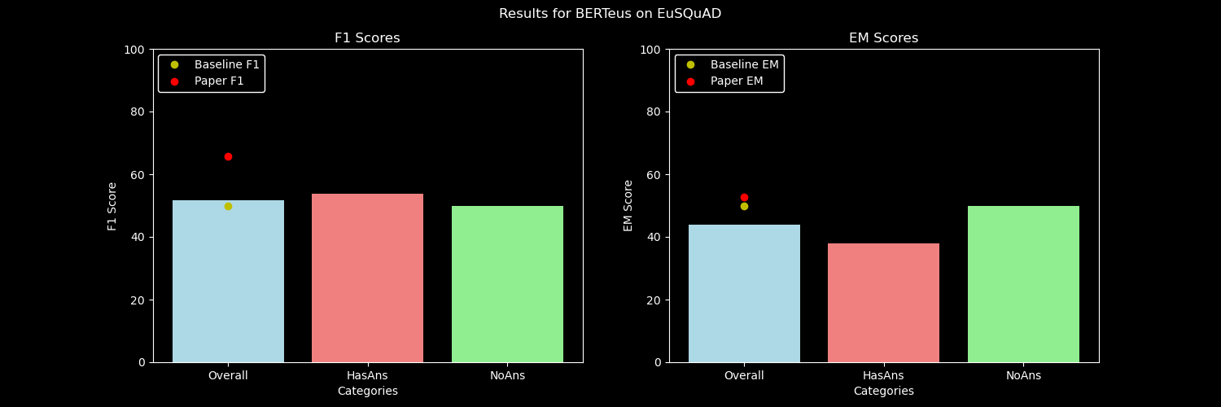
Question Answering NLP: results on the Basque QA
Keeping it simple: using the same hyperparameters as those in the EuSQuAD paper, can we replicate the results?
EuSQuAD Dataset
Main conclusions:
mBERT performs well on unanswerable questions (likely over-predicts as unanswerable). Raises overall F1 and EM but has poor performance on answerable questions. So multilingual pre-trained models may miss specific Basque linguistic patterns
Basque pre-trained models have lower overall EM and F1, but do better in answerable questions
BERTeus is gives the most balanced performance
Results do not match EuSQuAD paper's performance levels. Possible reasons:
Different test sets or fine-tuning processes.Different hyperparameters.
Their test set only contains answerable questions, affecting difficulty.
Reduced training data (to create a test set) may have also impacted performance.

Slide 21
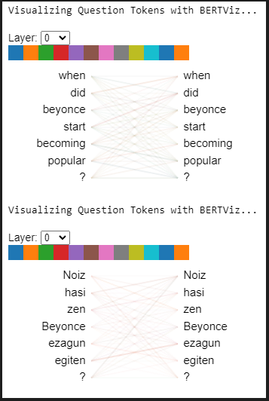
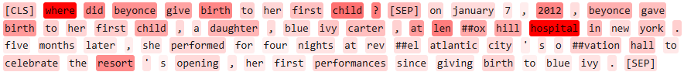
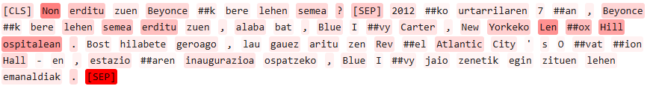
Question Answering NLP: Understanding how the fine-tuned models work towards predicting the answer
Visualizing the attention layers
Tokens draw information from other tokens
Visualizing the token weights from the reverse gradient
Each tokens’ overall contribution to the answer
-> note how the model understands “where” refers to locations, and gives weights to location names, “hospital” and “resort”

Slide 22
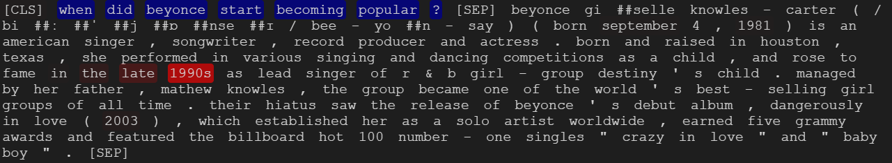
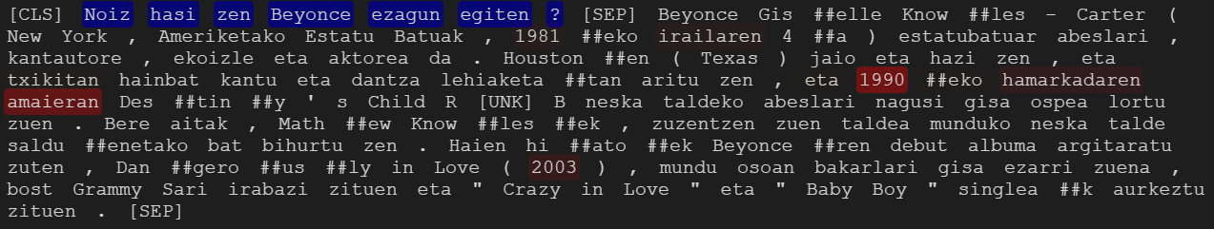
Question Answering NLP: Understanding how the fine-tuned models work towards predicting the answer
Visualizing the prediction scores:
The total probability that those words are part of the answer

Slide 23
Question Answering NLP: Conclusions and future work
Conclusions
Adapted QA models for Basque showed promise but remain far from human or SOTA performance.
Performance analysis by question type revealed key strengths and weaknesses.
Visualizations highlighted how models reason and process input, guiding improvements.
Limitations and Future Work:
No public test sets; custom splits introduced potential context overlap.
Hyperparameters were not fully optimized for Basque.Limited
Basque corpora damaged pre-training; more diverse data is needed.

Slide 24
A final word about the aim and scope of this project
Context(written by me): Most importantly, the main objective of this work is to raise awareness of the importance of supporting and advancing NLP research in minority languages. By showcasing the potential of adapting large language models to underrepresented languages like Basque, I hope to encourage further exploration and investment in this area. Future work could focus on improving the quality and size of training data, developing more sophisticated models tailored to the linguistic properties of Basque, or using tools to expand and educate the Basque-speaking ML community about the workarounds of NLP architectures, and how these models learn language concepts.
Question: What is the main aim of this work?
Predicted Answer: to raise awareness of the importance of supporting and advancing nlp research in minority languages
Question: What would I like to encourage?
Predicted Answer: further exploration and investment
Question: What can we teach the Basque-speaking ML community?
Predicted Answer: workarounds of nlp architectures
Question: What could future work focus on?
Predicted Answer: improving the quality and size of training data

